Slide 1

Intro To Machine Learning
IEEE AUS in collaboration with GDSC AUS
Workshop by Rohan Mitra

Slide 2
K-Nearest Neighbors
Classification Algorithm
Simple yet powerful
Instance based learning
The model is the data – Completely dependent on the dataset itself
Based on distances

Slide 3
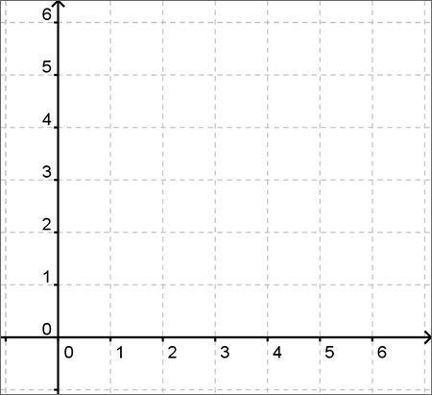
1-Nearest Neighbor
1
2
3
1
2
Find the nearest neighbor to the Red point
3

Slide 4
1-Nearest Neighbor
Find the closest neighbor, what next?
Pick the class of the new point to be the same as the closest point!
Is it a good idea to just use one point?

Slide 5
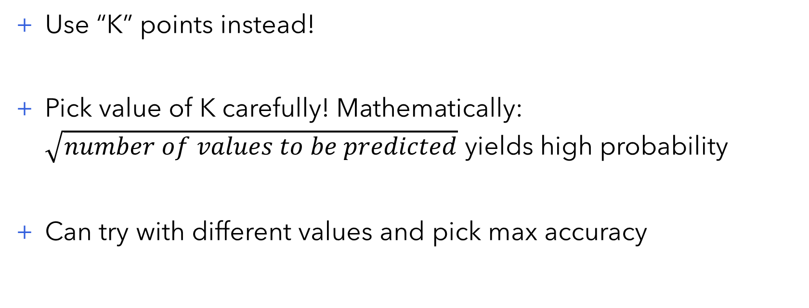
K-Nearest Neighbors
Use “K” points instead!
Pick value of K carefully! Mathematically: $\sqrt{number of values to be predicted}$ yields high probability
Can try with different values and pick max accuracy

Slide 6

4-Nearest Neighbors
Find the 4 nearest neighbors to the Red point
Classify red point as the mode of the closest points
3 Green points – 1 Blue point
Class – Majority $→$ Green!

Slide 7
Additional Notes
Distance based – Range of data matters!
Normalize the data
Would be slow since it checks all the points!
Optimized implementations – kD Trees and Ball Trees
Assumes all attributes are equally important
Works well if data isn’t too noisy

Slide 8
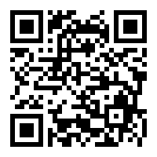


Thank you!
Find all code used in all workshops at: https://github.com/ro1406/MLWorkshop-IEEEAUS
Contact me on Instagram for any questions: @rohan14_official
While you're there, follow @ieee_aus and @gdscaus for updates!

